Slide 1

CORPORATE PRESENTATION
TKH GROUP The Solution provider

Slide 2

About TKH GROUP
TKH Group, is an international leading operating group of companies based in the Netherlands in the Industrial ,Telecom and Building solutions field
1,484€
Mds
22,2%
of To
75
Turnover 2017
Innovation
Stock List Euronext
88 years of experience
151
M€
10,2%
Subsidiaries
& factories
EBITA
ROS

Slide 3
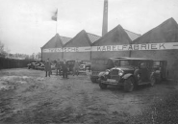

TKH GROUP history
TKF
Creation
Stock
market
TKH
Creation
1930
1952
1980
TKF creation
BV Twentsche Kaberlfabriek Cable manufacturing unit
Enter to the Stock list Euronext
(Netherlands)
N.V Twentsche Kabel was created after some companies acquisition
Stock transfert : TKF to TKH
2005
Twentsche Kabel Holding becomes TKH Group

Slide 4
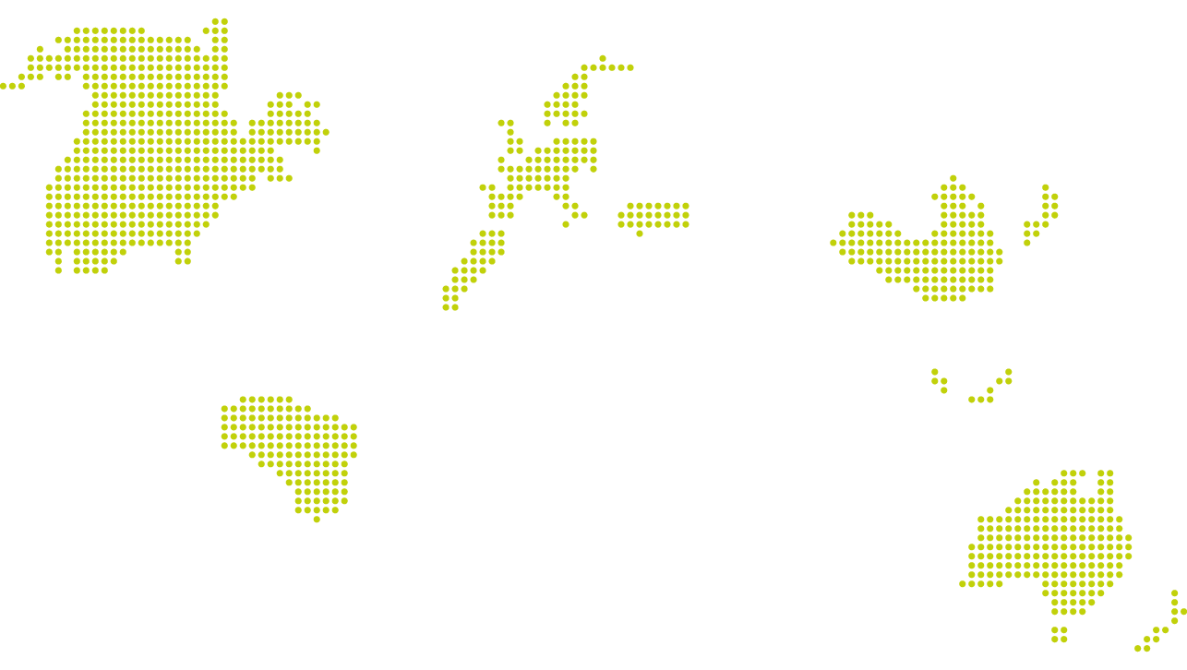
TKH GROUP worldwide
Headquarter in Haaksbergen (Netherlands)
GEOGRAPHICAL
DISTRIBUTION OF
TURNOVER
46%
21%
Europe
Asia
19%
10%
4%
Netherlands
North America
Others
5900
Employees

Slide 5

TKH GROUP Strategy
MISSION STATEMENT
TKH intends to be an innovative and leading technology niche player in creating combinations of technologies to total solutions.
CONFORT
+
+
+
VALUE
CREATION
EFFICIENCY
SAFETY - SECURITY

Slide 6



TKH GROUP Strategy
3 BUSINESS SEGMENTS
TELECOM SOLUTIONS
BUILDING SOLUTIONS
INDUSTRY SOLUTIONS
43%
13%
44%

Slide 7




TKH GROUP Strategy
A GLOBAL OFFER OF SYSTEMS
AND PRODUCT SOLUTIONS
4 CORE TECHNOLOGIES
VISION & SECURITY
COMMUNICATION
CONNECTIVITY
SMART MANUFACTURING
Face recognition
Video management
3D camera sensor technology
Intercom systems
Audio systems
Site management systems
(lighting, security systems…)
Structured cabling system
Subsea-connectivity systems
Microscopically connectivity systems
CEED® system- innovative technology monitors lighting on airfield runways
Analyze production line by
3D sensor
Remote guidance systems

Slide 8



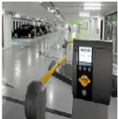
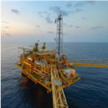
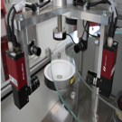
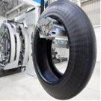
TKH GROUP Strategy
7 VERTICAL GROWTH MARKETS
FIBER OPTIC
NETWORKS
CARE
TUNNEL & INFRA
PARKING
MARINE &
OFFSHORE
MACHINE VISION
TIRE BUILDING
INDUSTRY

Slide 9
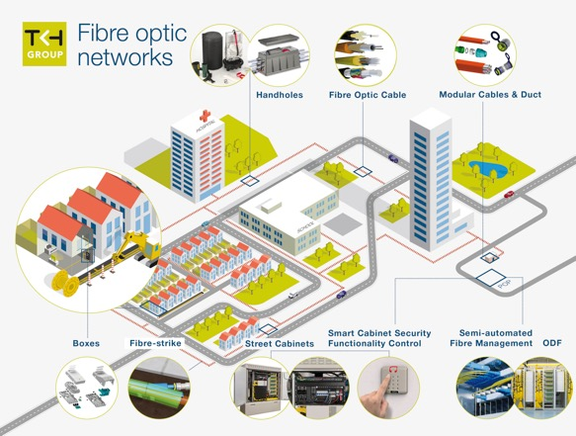
FIBER OPTIC Networks

Slide 10
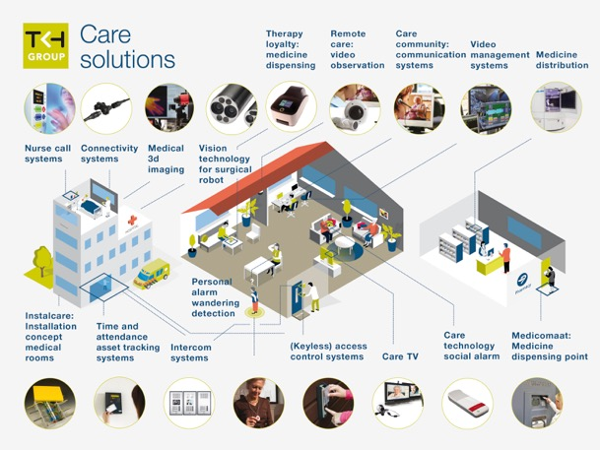
CARE Solutions

Slide 11
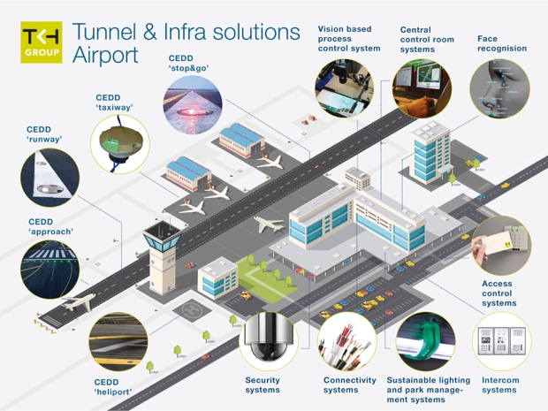
TUNNEL & INFRA Solutions

Slide 12
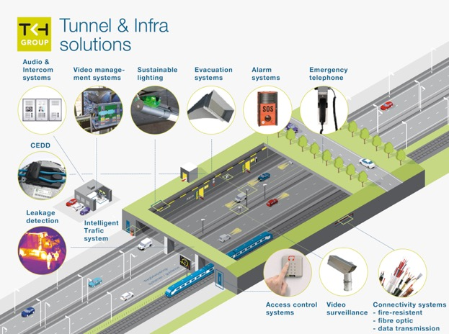
TUNNEL & INFRA Solutions

Slide 13
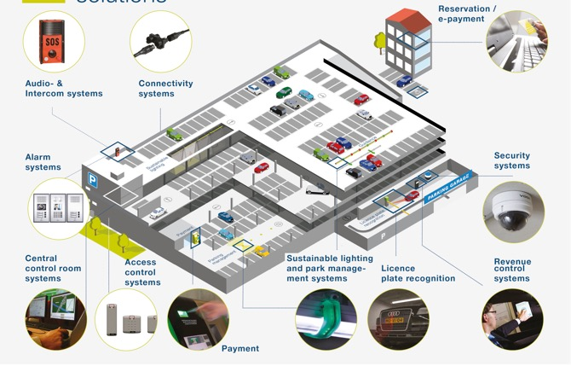
PARKING Solutions

Slide 14
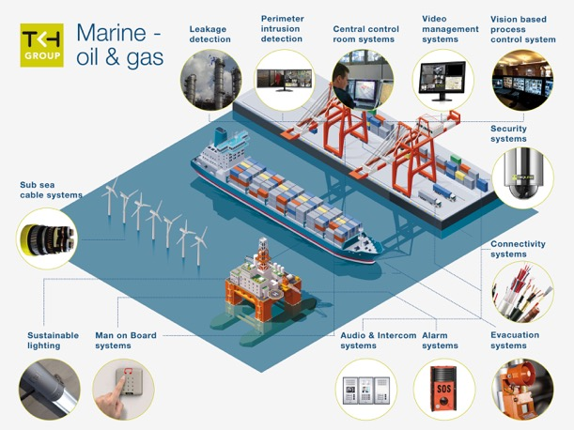
MARINE & OFFSHORE

Slide 15
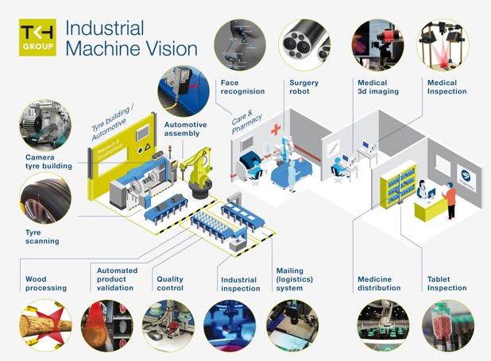
MACHINE VISION

Slide 16
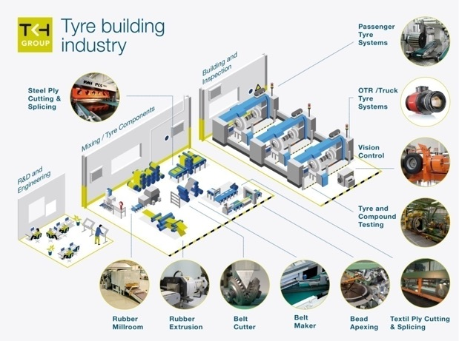
TIRE BUILDING Industry

Slide 17

TKH factories
A UNIQUE COMBINATION OF KNOW-HOW, TECHNICAL EXPERTISE & PRODUCTION CAPACITY
THE POWER OF AN INDUSTRIAL GROUP
+35 factories
Development of an extensive manufacturing network
Own industrial resources
Diversification
of manufacturing

Slide 18


TKH factories
A UNIQUE COMBINATION OF KNOW-HOW, TECHNICAL EXPERTISE & PRODUCTION CAPACITY
THE POWER OF AN INDUSTRIAL GROUP
TKF Lochem
Netherlands
TKF Netherlands
Netherlands
Industrial Communication
Marine, oil & gas
Fiber optic
cables
Industrial
instrumentation
& Infra cables
Subsea cables

Slide 19



TKH factories
A UNIQUE COMBINATION OF KNOW-HOW, TECHNICAL EXPERTISE & PRODUCTION CAPACITY
Germany
Italy
TFO China
ZTC China
Miniature cables
for robotics,
medical & security
cables
Machine tool industry
Audio cables
Fiber optic (from
preform silice to
assembly cables)
Data transmission -
communication &
industrial cables

