Slide 1
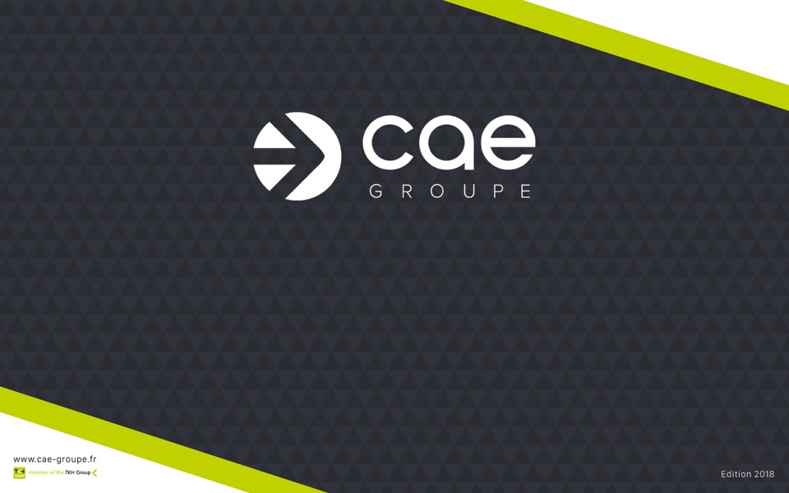
CORPORATE PRESENTATION
CONCEPTION OF INNOVATIVE SOLUTIONS
CABLING, CONNECTIVITY AND COMMUNICATION

Slide 2

About TKH GROUP
CAE GROUPE, SUBSIDIARY OF TKH GROUP
since 2007
TKH Group, is an international leading operating group of companies based in the Netherlands in the Industrial ,Telecom and Building solutions field
1,484€
Mds
22,2%
of To
75
Turnover 2017
Innovation
Stock List Euronext
88 years of experience
151
M€
10,2%
Subsidiaries
& factories
EBITA
ROS

Slide 3

About TKH GROUP
TKH GROUP WORLDWIDE
Headquarter in Haaksbergen (Netherlands)
GEOGRAPHICAL
DISTRIBUTION OF
TURNOVER
46%
21%
Europe
Asia
19%
10%
4%
Netherlands
Others
North America
5900
Employees

Slide 4

About TKH GROUP
TKH GROUP STRATEGY
Mission statement
TKH intends to be an innovative and leading technology niche player in creating combinations of technologies to total solutions.
COMFORT
VALUE
CREATION
+
+
+
EFFICIENCY
SAFETY - SECURITY

Slide 5




About TKH GROUP
TKH GROUP STRATEGY :
4 core technologies
A GLOBAL OFFER OF SYSTEMS
AND PRODUCT SOLUTIONS
VISION & SECURITY
COMMUNICATION
CONNECTIVITY
SMART MANUFACTURING
Face recognition
Video management
3D camera sensor technology
Intercom systems
Audio systems
Site management systems
(lighting, security systems…)
Structured cabling system
Subsea-connectivity systems
Microscopically connectivity systems
CEED® system- innovative technology monitors lighting on airfield runways
Analyze production line by
3D sensor
Remote guidance systems

Slide 6

About TKH GROUP
CAE GROUPE BENEFITS FROM THE FULL SUPPORT OF TKH FACTORIES
A unique combination of know-how, technical expertise & production capacity
THE POWER OF AN INDUSTRIAL GROUP
Development of an extensive manufacturing network
+35 factories
Own industrial resources
Diversification
of manufacturing

Slide 7
About CAE GROUPE
SINCE 1987
CAE GROUPE, a never-ending evolution company
CAE
Founded
in
INDUSTRIE
AXITRONIC
S2CEB
MULTIMEDIA
CONNECT
1987
1989
1991
1992
1993
Distribution of
audio cables and antennas
Distribution of
industry cables
Creation
of Axitronic
TV distribution
Acquisition & creation
of S2CEB
Audio/Video
Creation
of MMC
LAN network

Slide 8

About CAE GROUPE
SINCE 1987
CAE GROUPE, a never-ending evolution company
AXILOGIC
SOFICABEL
KCINDUSTRIE
CDC
Dubai
AXCEB
1999
2000
2001
2004
2007
Openning of Axilogic
R&D center and manufacturing of connectivity
Acquisition
of Soficabel
In Belgium
Acquisition of KCI
Manufacturing cables
for Industry
Distribution partnership development
With CDC in the Emirates
Creation
of AXCEB
Audio system
2007
Part of TKH GROUP

Slide 9






About TKH FRANCE
2007
Creation of a French Holding
CREATION
2007
Part of
TKH GROUP
TELECOM
FRANCE

Slide 10
About CAE GROUPE
CAE GROUPE
Multispecialist manufacturer
CAE GROUPE designs, develops and manufactures innovative cabling, connectivity and communication solutions
102
M€
190
1987
7
Established
Turnover
(2017)
Employees
Including 80 TKH France delegates
Sales
agencies

Slide 11

About CAE GROUPE
CAE GROUPE
Presence in France and worldwide
DOM
TOM
North Africa
French overseas sales agency
Paris
5
Nantes
Headquarters
Sales
Agencies in
FRANCE
Asia
South America
EMEA
Europe
…
International sales agency
Lyon
Toulouse
Marseille

Slide 12
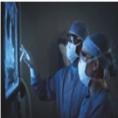
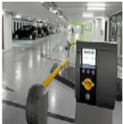



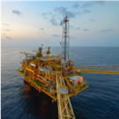
Strategy model CAE GROUPE
CARE
A BUSINESS APPROACH
in vertical growth markets
INFRASTRUCTURE
PARKING
Transport
Telecom
Utilities
(water, gas, electricity)
MARINE &
OFFSHORE

Slide 13

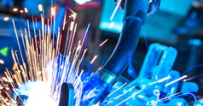
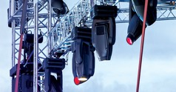
Multispecialist manufacturer
INNOVATIVE SOLUTIONS
Cables, Connectivity and Communication
in 3 business segments
SMART BUILDING
INDUSTRY
LIVE
AUDIO VIDEO BROADCAST

Slide 14






Multispecialist manufacturer
INNOVATIVE SOLUTIONS
Cables, Connectivity and Communication
in 3 business segments
SMART
BUILDING
INDUSTRY
LIVE AUDIO VIDEO
BROADCAST
Commercial
Building
Connectivity
Residential
Building
Communication
Commercial & Residential Building

Slide 15



Businesses and brands
A UNIQUE COMBINATION
of know-how and technologies
Structured cabling for IP network, Datacenters, Smart building
Building security and telephone
Building
Connectivity
SMART BUILDING
Residential
Connectivity
Residential Cabling
TV distribution solutions
FTTH in-building cabling
Building
Communication
Public adress & Security sound solutions

Slide 16
Businesses and brands
A UNIQUE COMBINATION
of know-how and technologies
Industrial environments
Special machines, Food industry, Packing industry, Marine, Petrochemicals,
Nuclear plant & ENR…
Industrial equipments
Control cables, field bus cables, drag chain cables, Instrumentation…
Industry 4.0
Interconnected global solution (automation and robotization)
Industrial cabling solutions
INDUSTRY

Slide 17

Businesses and brands
A UNIQUE COMBINATION
of know-how and technologies
Entertainment
Regies
Studios
Meeting & Conference Rooms…
Cabling solutions for Live and audiovisual
LIVE
A/V BROADCAST

Slide 18


Our offer and businesses
A COMPLETE OFFER
For Smart Building
Copper solutions
Optical fiber solutions
Cabinets and racks solutions
Radiofrequency cabling solutions
Security cabling solutions
STRUCTURED
CABLING SYSTEMS

Slide 19


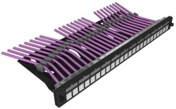
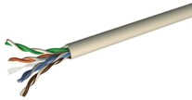








Our offer and businesses
A COMPLETE OFFER
COPPER
SOLUTIONS
For Smart Building
CABLES
CONNECTIQUE
CAT5E - CAT8
Telephone
Fire resistance
Alarm
Coaxials
Smart metering
RJ45 connectors
19’’ patch panel
Faceplates
RJ45 patchcords

Slide 20









Our offer and businesses
A COMPLETE OFFER
FIBER
SOLUTIONS
For Smart Building
OPTICAL FIBER CABLES
CONNECTIVITY
Indoor / outdoor applications
Single mode OS2
Multimode OM3, OM4,OM5
Fiber optic patch panel
Pigtails
Adapters
Fiber optic patch cords
PRE-TERMINATED
SOLUTIONS

Slide 21



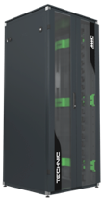
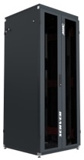
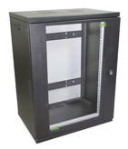




Our offer and businesses
RACKS
A COMPLETE OFFER
For Smart Building
19 ’’ CABINETS
WALL MOUNTED CABINETS
ACCESSORIES
Flat Pack
Flat Pack

Slide 22

Our offer and businesses
A COMPLETE OFFER
For Smart Building
COMFORT AND SAFETY SOUND SOLUTIONS
100 volts sound comfort system
Safety sound solutions (PPMS)
Induction Loop Brand

Slide 23

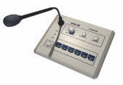



Our offer and businesses
A COMPLETE OFFER
COMFORT
SOUND
For Smart Building
100 VOLTS
SOUND
INDUCTION LOOP BRAND
Speakers
Amplifiers
Preamplifiers
Microphone pupitre
Matrix system
Sources
UHF Microphone …
Amplifiers
UHF systems
Cables
…

Slide 24
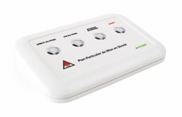




Our offer and businesses
A COMPLETE OFFER
For Smart Building
SAFETY
SOUND SOLUTIONS
Special plan for security

Slide 25

Our offer and businesses
A COMPLETE OFFER
For Residential building
TV DISTRIBUTION
SOLUTIONS
RESIDENTIAL CABLING
Signal reception
Signal processing and distribution
Coaxial cables and connectivity
Communication cabinets and accessories
Grade 3 TV cable (2,2 Mhz)
FTTH IN-BUILDING
CABLING
Drop cables and plugs
Backbone cables

Slide 26

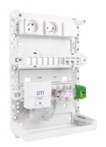
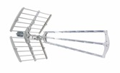






Our offer and businesses
A COMPLETE OFFER
For Residential building
RESIDENTIAL
CABLING
TV DISTRIBUTION
SOLUTIONS
Communication cabinets and accessories
Grade 3 TV cable
(2,2 Mhz)
Signal reception
Signal processing and distribution
Coaxial cables and connectivity

Slide 27
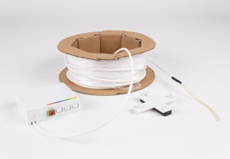
Our offer and businesses
A COMPLETE OFFER
For Residential building
FTTH IN-BUILDING
CABLING
Riser cables
Preterminated subscriber cables

Slide 28

Our offer and businesses
A COMPLETE OFFER
Industrial cabling solutions
Industrial
sectors
Industry 4.0
Industrial equipments
Special machines, Food industry, Packing industry, Marine, Petrochemicals,
Nuclear plant & ENR…
Interconnected global solution (automation and robotization)
Control cables, field bus cables, drag chain cables, Instrumentation…

Slide 29
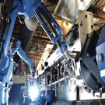
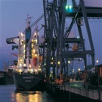
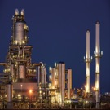
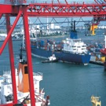
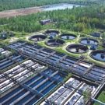
Our offer and businesses
A COMPLETE OFFER
Industrial cabling solutions
Process and automation
INDUSTRIAL SECTORS
Marine
Petrochemical
Handling and lifting
Water treatment

Slide 30






Our offer and businesses
A COMPLETE OFFER
Industrial cabling solutions
DRAG CHAIN CABLES
CONTROL CABLES
HIGH TEMPERATURE CABLES
POWER
CABLES
FIELD BUS CABLES

Slide 31
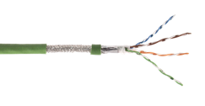


Our offer and businesses
A COMPLETE OFFER
Industrial cabling solutions
INDUSTRY 4.0
SOLUTION
INSTRUMENTATION
CABLES
NFM 87-202
Cables and connectivity
(RJ45, IP67 solutions, M12…)
C1 CERTIFIED CABLES
MARINE
SOLUTION
(Fire retardant)
Nuclear plant & Infrastructure
DNV certified
Also…
DATA TRANSMISSION CABLES
POWER HARMONISED CABLES
WIRING CABLES
PHOTOVALTAIC CABLES AND CONNECTIVITY

Slide 32


Our offer and businesses
A COMPLETE OFFER
for Live and audiovisual
Entertainment
Regies
Studios
Meeting & Conference Rooms…
CABLES
CONNECTIVITY
CORDS AND CABLING SYSTEMS
PRE-CABLING
AUDIOVISUAL
19’’PATCHPANEL AND STAGE BOXES
CABLE REELS
CABLING SOLUTIONS
FOR LIVE AND AUDIOVISUAL

Slide 33



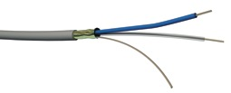
Our offer and businesses
A COMPLETE OFFER
for Live and audiovisual
CABLES
CONNECTIVITY
Audio
Video
Lighting
Ethernet
Optical fiber
Audio
Video
Fiber channels
cords
…

Slide 34




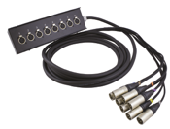
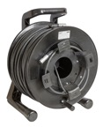
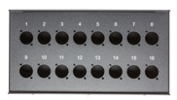
Our offer and businesses
A COMPLETE OFFER
for Live and audiovisual
CORDS AND CABLING SYSTEMS
AUDIOVISUAL
PRE-CABLING
Wallplates
19’’PATCHPANEL AND
STAGE BOXES
CABLE REELS

Slide 35






Innovative solutions
OUR LATEST INNOVATIONS
SMART
& SIMPLE
TO DEVELOP AND MANUFACTURE
Innovative cabling solutions
Changeable section cable for induction loop brand
First RJ45 tooless connector with ceramic blade
Secure facilities with locking system
Faceplate – Plug - cords
Tooless plug
And rotary 135° multifonction plug
Patch panel with 3 nut cage fixation and rotary cable management blocs

Slide 36



A answer for each necessity
ATTENTIVE
TO YOUR NEEDS
SOLUTIONS AND SERVICES
Technical specs design and development
FIRST training center
Hotline
Specific cables and customization
Pre-assembled RJ45 and
preloaded panels
Special measure cables manufacture
Copper and optical pre-termination
Cords development workshop
Start-up on site
Cable cutting upon request
Labelling and packaging customization
Warehouse for projects and customers
Delivery upon request

Slide 37
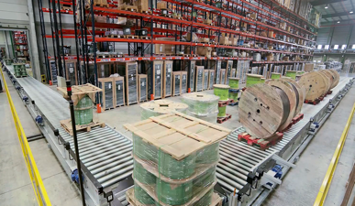
A master logistic capacity
LOGISTIC MEANS
for better customer service
FLEXIBILITY OF OUR
LOGISTICS RESSOURCES
2 logistics plate-forms (Paris & Toulouse)
Our site is managed by WMS
Fully automated machines site
EDI Plate-form

Slide 38
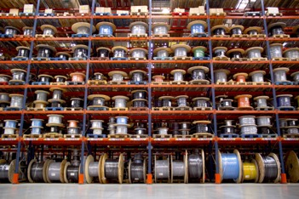
A master logistic capacity
LOGISTIC MEANS
for better customer service
FLEXIBILITY OF OUR
LOGISTICS RESSOURCES
Storage area
Cutting/year
Preparations lines/year
Expeditions /year
Pallet zones
30 000 m²
51 000
300 000
12 600 Tons
18 000

Slide 39
Quality and CSR
A COMMITTED GROUP
With strong values
CORPORATE SOCIAL RESPONSABILITY
OUR QUALITY COMMITMENTS
SUSTAINABLE DEVELOPMENT
AND ECOLOGY
Environmental policy
(reduction of energy, CO2 and waste
SUPPLIER CODE OF CONDUCT
Ethics and prevention
SOCIAL ENGAGEMENT AND ENTREPRENEURIAL POLICY
Respect for human and children's rights
Health and security
STANDARDS EXPECTECTATIONS
CE, NF, CPR, Marine certification
QUALITY & PROCESS
ISO 9001
OUR PRODUCTS CERTIFICATIONS
Independant laboratories :
LCIE, DELTA FORCE, ETL, 3P, ...)
Corporate Social Responsibility (CSR) policy is at the heart of our Group's strategy. It is based on the implementation of a set of values, principles, standards and actions respectful of the environment and ethical business conduct.

